Slide 1
Apache TomCat 8 Administration
Rajesh Pasham

Slide 2
COURSE OVERVIEW
In this course, you will learn how to install and configure Apache Tomcat 8, as well as learn the key mechanisms of installing and administering Web Applications.
This course emphasizes altering key configuration artifacts for optimum performance, availability, and fault tolerance.
You will learn about integration with existing security mechanisms and databases, as well as high-performance scalability, clustering, and fault-tolerant fail-over techniques.

Slide 3
WHAT YOU'LL LEARN
How Tomcat relates to Java EE (JEE) and compares to other application servers (e.g., JBoss)
Install and setup Tomcat on UNIX-type environments
Deploy, support, and troubleshoot applications on Tomcat
Navigate Tomcat's directory structure
Tomcat architecture and configuration files: server.xml, context.xml, .properties, etc.

Slide 4
WHAT YOU'LL LEARN
Web application structure and configuration: web.xml
Secure Tomcat and applications running on it
Set-Up Tomcat for SSL
Tune Tomcat's performance
Explore different load-balancing and high-availability strategies with Tomcat, including server affinity through sticky sessions as well as session replication via Tomcat
Clustering

Slide 5
OUTLINE
1. Apache Tomcat and JEE Overview
Web Technology Architectural Overview
Servlets 3.1
JSP 2.3
WebSockets 1.1
Expression Language 3.0
Tomcat Background
Other components in the ecosystem

Slide 6
OUTLINE
2. Administering Apache Tomcat
Apache and Tomcat
Installing Tomcat
Directory Structure

Slide 7
OUTLINE
3.Configuration Files
Anatomy of a Web App
Deploying Web Apps
Tomcat Manager
Connection Pooling and Database Mappings
Tomcat Security and LDAP Integration

Slide 8
OUTLINE
4.Performance
Capacity Planning
Garbage Collection and Tuning Overview
Deploying and Configuring Web Applications
Advanced Performance-Tomcat Native and APR
Load Testing with Apache JMeter (Optional)

Slide 9
OUTLINE
5.Clustering
Clustering Tomcat
Connectors (JCA) (Optional)
Integrating with Apache HttpD and Mod-Cluster
Shared Hosting (Optional)

Slide 10
Overview of Java Enterprise Edition
What is Java EE?
Java EE is an open and standard-based platform for developing, deploying, and managing multi-tier, web-enabled, server-centric, and component-based enterprise applications
Open and Standard-based
Multi-tier
OO framework for integrating together:
Clients (e.g. web browsers)
Access and presentation components

Slide 11
Overview of Java Enterprise Edition
Business components (e.g. ecommerce business logic)
Data-stores (e.g. RDBMS)
Legacy systems (e.g. order fulfillment)
System-level separation of concerns

Slide 12
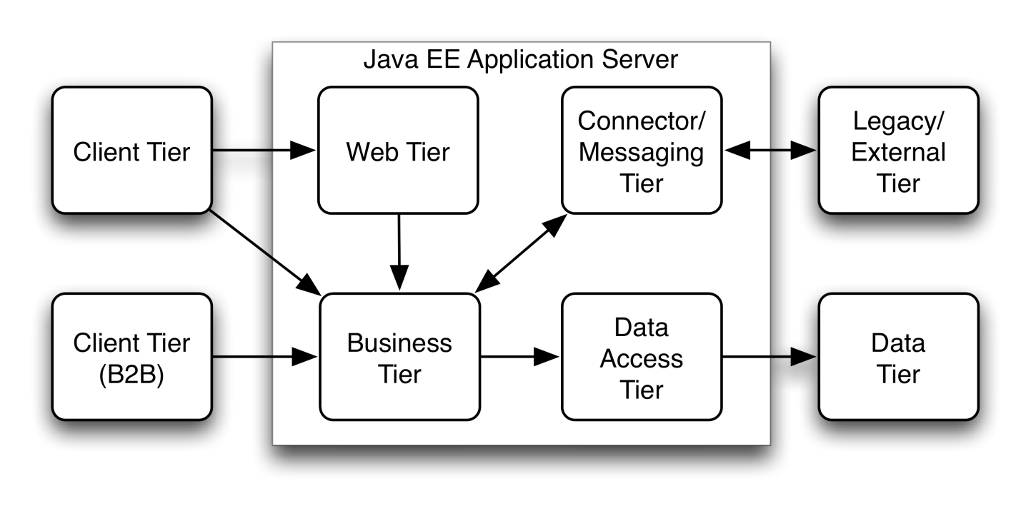
Overview of Java Enterprise Edition
Multi-tier Architecture

Slide 13
Overview of Java Enterprise Edition
Web-Enabled
Thanks to Servlet/JSP technology, Java EE applications are automatically web-enabled:
Complete support for web-services
Clients
End-points

Slide 14
Overview of Java Enterprise Edition
Server Centric
Java EE apps run within a Java EE application server that provides all middle-tier services.
Thin (web-based) clients
Support for rich clients through RMI, Web Services, etc.
The design of such clients is beyond the scope of Java EE

Slide 15
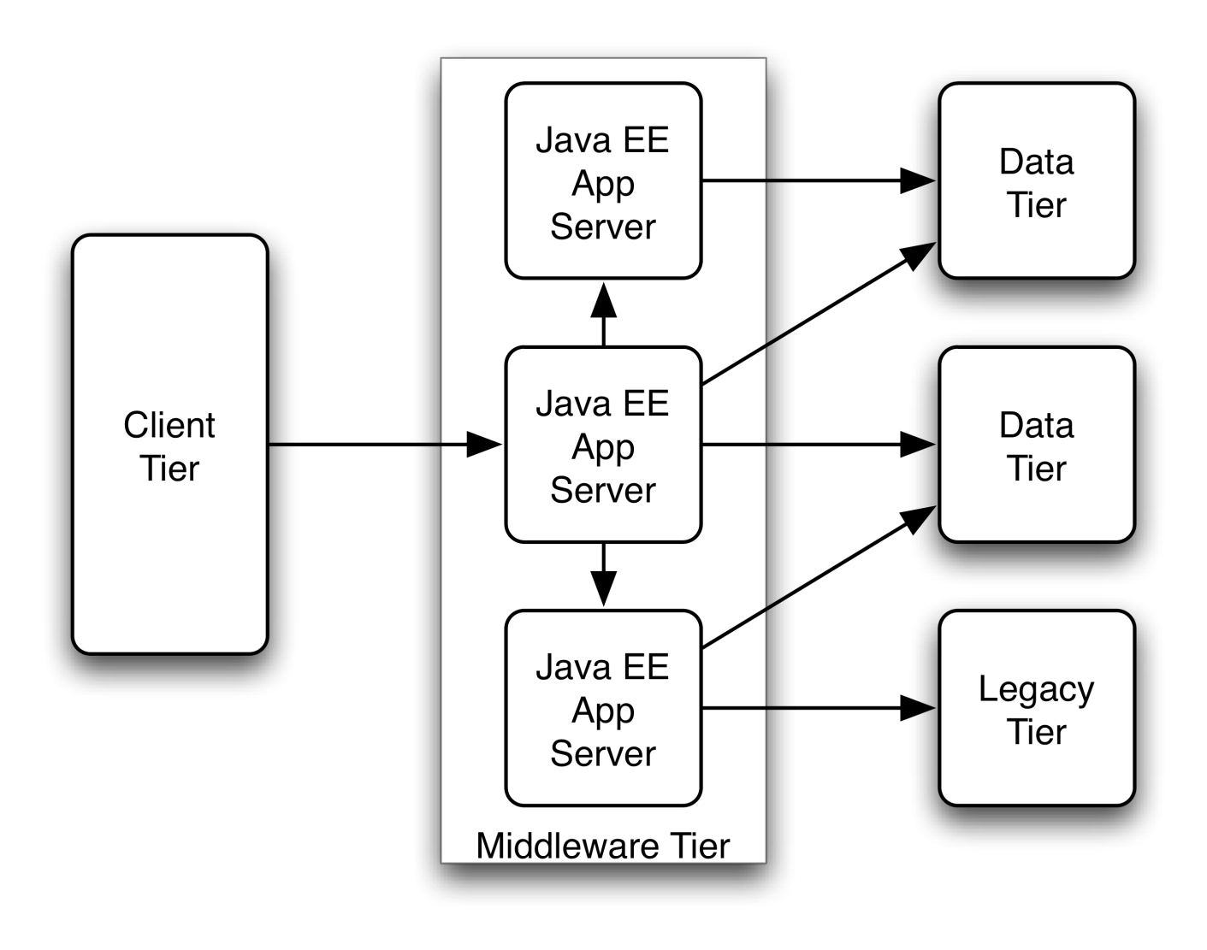
Overview of Java Enterprise Edition
Component-Based Distributed Architecture

Slide 16
Overview of Java Enterprise Edition
Enterprise Applications
Java EE applications are made up of:
Presentation logic
Business logic
Data access logic and model
Java EE facilitates separation of concerns
The goal of Java EE is to significantly reduce the cost, time, and complexity of developing and managing multi-tier enterprise applications.

Slide 17
Introduction
Apache Tomcat version 8.0 implements the Servlet 3.1 and JavaServer Pages 2.3 specifications from the Java Community Process, and includes many additional features that make it a useful platform for developing and deploying web applications and web services.
Terminology
Context - In a nutshell, a Context is a web application.
Directories and Files
$CATALINA_HOME represents the root of your Tomcat installation.
Tomcat may be configured for multiple instances by defining $CATALINA_BASE for each instance.
If multiple instances are not configured, $CATALINA_BASE is the same as $CATALINA_HOME.

Slide 18
Introduction
Directories and Files
These are some of the key tomcat directories:
/bin - Startup, shutdown, and other scripts. The .sh files
/conf – Configuration files and related DTDs. The most important file is server.xml
/logs – Log files are here by default.
/webapps – This is where your webapps go.

Slide 19
Configuring Tomcat
All of the information in the configuration files is read at startup, meaning that any change to the files necessitates a restart of the container.

Slide 20
Tomcat Setup
Apache Tomcat 8.0 requires a Java Standard Edition Runtime Environment (JRE) version 7 or later.
Running With JRE 7 Or Later
Download and Install a Java SE Runtime Environment (JRE)
Download and Install Apache Tomcat
Download a binary distribution of Tomcat from: https://tomcat.apache.org/
Unpack the binary distribution so that it resides in its own directory (conventionally named "apache-tomcat-[version]")
"CATALINA_HOME" is used to refer to the full pathname of that directory.

Slide 21
Tomcat Setup
Configure Environment Variables
Set CATALINA_HOME (required) and CATALINA_BASE (optional)
Set JRE_HOME or JAVA_HOME (required)

Slide 22
Start Up Tomcat
Tomcat can be started by executing one of the following commands:
$CATALINA_HOME/bin/startup.sh
or
$CATALINA_HOME/bin/catalina.sh start
After startup, the default web applications included with Tomcat will be available by visiting:
http://localhost:8080/

Slide 23
Shut Down Tomcat
Tomcat can be shut down by executing one of the following commands:
$CATALINA_HOME/bin/shutdown.sh
or
$CATALINA_HOME/bin/catalina.sh stop

Slide 24
Manager App
In many production environments, it is very useful to have the capability to deploy a new web application, or undeploy an existing one, without having to shut down and restart the entire container.
In addition, you can request an existing application to reload itself, even if you have not declared it to be reloadable in the Tomcat server configuration file.
To support these capabilities, Tomcat includes a web application (installed by default on context path /manager) that supports the following functions:

Slide 25
Manager App
Deploy a new web application from the uploaded contents of a WAR file
Deploy a new web application, on a specified context path, from the server file system.
List the currently deployed web applications, as well as the sessions that are currently active for those web apps.
Reload an existing web application, to reflect changes in the contents of /WEB-INF/classes or /WEB-INF/lib.
List the OS and JVM property values.

Slide 26
Manager App
List the available global JNDI resources, for use in deployment tools that are preparing <ResourceLink> elements nested in a <Context> deployment description.
Start a stopped application (thus making it available again).
Stop an existing application (so that it becomes unavailable), but do not undeploy it.
Undeploy a deployed web application and delete its document base directory (unless it was deployed from file system).

Slide 27
Configuring Manager Application Access
The Manager application is shipped with the requirement that anyone who attempts to use it must authenticate themselves, using a username and password that have one of manager-xxx roles associated with them.
There is no username in the default users file ($CATALINA_BASE/conf/tomcat-users.xml) that is assigned to those roles
Therefore, access to the Manager application is completely disabled by default.

Slide 28
Configuring Manager Application Access
You can find the role names in the web.xml file of the Manager web application.
The available roles are:
manager-gui — Access to the HTML interface.
manager-status — Access to the "Server Status" page only.
manager-script — Access to the tools-friendly plain text interface, and to the "Server Status" page.
manager-jmx — Access to JMX proxy interface and to the "Server Status" page.

Slide 29
Configuring Manager Application Access
To enable access to the Manager web application, you must either create a new username/password combination and associate one of the manager-xxx roles with it, or add a manager-xxx role to some existing username/password combination.
UserDatabaseRealm plus MemoryUserDatabase, or MemoryRealm — The UserDatabaseRealm and MemoryUserDatabase are configured in the default $CATALINA_BASE/conf/server.xml.

Slide 30
Configuring Manager Application Access
Both MemoryUserDatabase and MemoryRealm read an XML-format file by default stored at $CATALINA_BASE/conf/tomcat-users.xml
This file contains an XML <user> for each individual user, which might look something like this:
<user username=“manager" password="secret" roles="standard, manager-script" />
DataSourceRealm or JDBCRealm — Your user and role information is stored in a database accessed via JDBC.
JNDIRealm — Your user and role information is stored in a directory server accessed via LDAP.

Slide 31
Configuring Manager Application Access
The first time you attempt to issue one of the Manager commands, you will be challenged to log on using BASIC authentication.
The username and password you enter do not matter, as long as they identify a valid user in the users database who possesses the role manager-script.
In addition to the password restrictions, access to the Manager web application can be restricted by the remote IP address or host by adding a RemoteAddrValve or RemoteHostValve. Here is an example of restricting access to the localhost by IP address:

Slide 32
Configuring Manager Application Access
<Context privileged="true">
<Valve className="org.apache.catalina.valves.RemoteAddrValve"
allow="127\.0\.0\.1"/>
</Context>

Slide 33
HTML User-friendly Interface
The user-friendly HTML interface of Manager web application is located at
http://{host}:{port}/manager/html
Ex: http://localhost:8080/manager/html
You need manager-gui role to be allowed to access it.
The interface is divided into six sections:
Message - Displays success and failure messages.
Manager - General manager operations like list and help.

Slide 34
HTML User-friendly Interface
Applications - List of web applications and commands.
Deploy - Deploying web applications.
Diagnostics - Identifying potential problems.
Server Information - Information about the Tomcat server.
Message
Displays information about the success or failure of the last web application manager command you performed.
If it succeeded OK is displayed and may be followed by a success message.

Slide 35
HTML User-friendly Interface
If it failed FAIL is displayed followed by an error message.
Manager
The Manager section has three links:
List Applications - Redisplay a list of web applications.
HTML Manager Help - A link to this document.
Manager Help - A link to the comprehensive Manager App HOW TO.

Slide 36
HTML User-friendly Interface
Applications
The Applications section lists information about all the installed web applications and provides links for managing them. For each web application the following is displayed:
Path - The web application context path.
Display Name - The display name for the web application if it has one configured in its "web.xml" file.
Running - Whether the web application is running and available (true), or not running and unavailable (false).
Sessions - The number of active sessions for remote users of this web application. The number of sessions is a link which when submitted displays more details about session usage by the web application in the Message box.

Slide 37
HTML User-friendly Interface
Commands - Lists all commands which can be performed on the web application. Only those commands which can be performed will be listed as a link which can be submitted. No commands can be performed on the manager web application itself. The following commands can be performed:
Start - Start a web application which had been stopped.
Stop - Stop a web application which is currently running and make it unavailable.
Reload - Reload the web application so that new ".jar" files in /WEB-INF/lib/ or new classes in /WEB-INF/classes/ can be used.
Undeploy - Stop and then remove this web application from the server.

Slide 38
HTML User-friendly Interface
Deploy
Web applications can be deployed using files or directories located on the Tomcat server or you can upload a web application archive (WAR) file to the server.
To install an application, fill in the appropriate fields for the type of install you want to do and then submit it using the Install button.
Deploy directory or WAR file located on server
Deploy and start a new web application, attached to the specified Context Path:

Slide 39
HTML User-friendly Interface
Deploy a Directory or WAR by URL
Install a web application directory or ".war" file located on the Tomcat server.
If no Context Path is specified, the directory name or the war file name without the ".war" extension is used as the path.
Diagnostics
Finding memory leaks
The find leaks diagnostic triggers a full garbage collection. It should be used with extreme caution on production systems.

Slide 40
HTML User-friendly Interface
The find leaks diagnostic attempts to identify web applications that have caused memory leaks when they were stopped, reloaded or undeployed.
This diagnostic will list context paths for the web applications that were stopped, reloaded or undeployed, but which classes from the previous runs are still present in memory, thus being a memory leak
Server Information
This section displays information about Tomcat, the operating system of the server Tomcat is hosted on, the Java Virtual Machine Tomcat is running in, the primary host name of the server and the primary IP address of the server.

Slide 41
Supported Manager Commands
All commands that the Manager application knows how to process are specified in a single request URI like this:
http://{host}:{port}/manager/text/{command}?{parameters}
The commands are usually executed by HTTP GET requests. The /deploy command has a form that is executed by an HTTP PUT request.
Common Parameters
Most commands accept one or more of the following query parameters:

Slide 42
Supported Manager Commands
path - The context path (including the leading slash) of the web application you are dealing with. To select the ROOT web application, specify "/".
version - The version of this web application as used by the parallel deployment feature. If you use parallel deployment wherever a path is required you must specify a version in addition to the path and it is the combination of path and version that must be unique rather than just the path.
war - URL of a web application archive (WAR) file, or pathname of a directory which contains the web application, or a Context configuration ".xml" file. You can use URLs in any of the following formats:
file:/absolute/path/to/a/directory

Slide 43
Supported Manager Commands
file:/absolute/path/to/a/webapp.war
file:/absolute/path/to/a/context.xml
Directory - The directory name for the web application context in the Host's application base directory.
webapp.war - The name of a web application war file located in the Host's application base directory.
Each command will return a response in text/plain format

Slide 44
Supported Manager Commands
Deploy a Directory or WAR by URL
Deploy a web application directory or ".war" file located on the Tomcat server.
The war parameter specifies a URL (including the file: scheme) for either a directory or a web application archive (WAR) file.
Ex: http://localhost:8080/manager/text/deploy?path=/sample&war=file:/c://sample.war

Slide 45
Supported Manager Commands
List Currently Deployed Applications
http://localhost:8080/manager/text/list
Reload An Existing Application
http://localhost:8080/manager/text/reload?path=/examples
List OS and JVM Properties
http://localhost:8080/manager/text/serverinfo

Slide 46
Supported Manager Commands
List Available Global JNDI Resources
http://localhost:8080/manager/text/resources[?type=xxxxx]
Session Statistics
http://localhost:8080/manager/text/sessions?path=/examples
Expire Sessions
http://localhost:8080/manager/text/expire?path=/examples&idle=num
Start an Existing Application
http://localhost:8080/manager/text/start?path=/examples

Slide 47
Supported Manager Commands
Stop an Existing Application
http://localhost:8080/manager/text/stop?path=/examples
Undeploy an Existing Application
http://localhost:8080/manager/text/undeploy?path=/sample
Finding memory leaks
http://localhost:8080/manager/text/findleaks[?statusLine=[true|false]]
Connector SSL/TLS diagnostics
http://localhost:8080/manager/text/sslConnectorCiphers

Slide 48
Supported Manager Commands
Thread Dump
http://localhost:8080/manager/text/threaddump
VM Info
http://localhost:8080/manager/text/vminfo
Save Configuration
http://localhost:8080/manager/text/save

Slide 49
Supported Manager Commands
Server Status
http://localhost:8080/manager/status
http://localhost:8080/manager/status/all
http://localhost:8080/manager/status?XML=true
http://localhost:8080/manager/status/all?XML=true

Slide 50
Tomcat Web Application Deployment
Deployment is the term used for the process of installing a web application into the Tomcat server.
Web application deployment can be accomplished in a number of ways within the Tomcat server.
Statically: the web application is setup before Tomcat is started
Dynamically: by directly manipulating already deployed web applications or remotely by using the Tomcat Manager web application

Slide 51
Tomcat Web Application Deployment
The Tomcat Manager is a web application that can be used interactively (via HTML GUI) or programmatically (via URL-based API) to deploy and manage web applications.
Apache Tomcat provides tasks for Apache Ant build tool.
Apache Tomcat Maven Plugin project provides integration with Apache Maven.

Slide 52
Tomcat Web Application Deployment
There is also a tool called the Client Deployer, which can be used from a command line and provides additional functionality such as compiling and validating web applications as well as packaging web application into web application resource (WAR) files.
In talking about deployment of web applications, the concept of a Context is required to be understood.
A Context is what Tomcat calls a web application.
In order to configure a Context within Tomcat a Context Descriptor is required.

Slide 53
Tomcat Web Application Deployment
A Context Descriptor is simply an XML file that contains Tomcat related configuration for a Context, e.g naming resources or session manager configuration.
Context Descriptors not only help Tomcat to know how to configure Contexts but other tools such as the Tomcat Manager and TCD often use these Context Descriptors to perform their roles properly.
The locations for Context Descriptors are:
$CATALINA_BASE/conf/[enginename]/[hostname]/[webappname].xml
$CATALINA_BASE/webapps/[webappname]/META-INF/context.xml

Slide 54
Tomcat Web Application Deployment
Deployment on Tomcat startup
The location you deploy web applications to for this type of deployment is called the appBase which is specified per Host.
You either copy a so-called exploded web application, i.e non-compressed, to this location, or a compressed web application resource .WAR file.
The web applications present in the location specified by the Host's (default Host is "localhost") appBase attribute (default appBase is "$CATALINA_BASE/webapps") will be deployed on Tomcat startup only if the Host's deployOnStartup attribute is "true".

Slide 55
Tomcat Web Application Deployment
Deploying on a running Tomcat server
If the Host autoDeploy attribute is "true", the Host will attempt to deploy and update web applications dynamically.
Deployment of .WAR files copied into the Host appBase.
Deployment of exploded web applications which are copied into the Host appBase.
Re-deployment of a web application which has already been deployed from a .WAR when the new .WAR is provided.

Slide 56
Host Manager App -- Text Interface
The Tomcat Host Manager application enables you to create, delete, and otherwise manage virtual hosts within Tomcat.
The Tomcat Host Manager application is a part of Tomcat installation, by default available using the following context: /host-manager.
You can use the host manager in the following ways:
Utilizing the graphical user interface, accessible at: {server}:{port}/host-manager/html.
Utilizing a set of minimal HTTP requests suitable for scripting. You can access this mode at: {server}:{port}/host-manager/text.

Slide 57
Host Manager App -- Text Interface
Configuring Manager Application Access
The Host Manager application requires a user with one of the following roles:
admin-gui - use this role for the graphical web interface.
admin-script - use this role for the scripting web interface.
For example, open ${CATALINA_BASE}/conf/tomcat-users.xml and enter the following:
<user username="test" password="secret" roles="admin-script"/>
When you now access {server}:{port}/host-manager/text/${COMMAND},you are able to log in with the created credentials.
$ curl -u ${USERNAME}:${PASSWORD} http://localhost:8080/host-manager/text/list

Slide 58
Host Manager App -- Text Interface
The following commands are supported:
list
add
remove
start
stop

Slide 59
Host Manager App -- Text Interface
List command
Use the list command to see the available virtual hosts on your Tomcat instance.
Ex: curl -u test:test http://localhost:8080/host-manager/text/list
Add command
Use the add command to add a new virtual host. Parameters used for the add command:
String name: Name of the virtual host. REQUIRED
String aliases: Aliases for your virtual host.

Slide 60
Host Manager App -- Text Interface
String appBase: Base path for the application that will be served by this virtual host. Provide relative or absolute path.
Boolean manager: If true, the Manager app is added to the virtual host. You can access it with the /manager context.
Boolean autoDeploy: If true, Tomcat automatically redeploys applications placed in the appBase directory.
Boolean deployOnStartup: If true, Tomcat automatically deploys applications placed in the appBase directory on startup.
Boolean deployXML: If true, the /META-INF/context.xml file is read and used by Tomcat.
Boolean copyXML: If true, Tomcat copies /META-INF/context.xml file and uses the original copy regardless of updates to the application's /META-INF/context.xml file. Available only for Tomcat 8 and newer.

Slide 61
Host Manager App -- Text Interface
Example command:
curl -u test:test http://localhost:8080/host-manager/text/add?name=www.awesomeserver.com&aliases=awesomeserver.com&appBase/mnt/appDir&deployOnStartup=true
Start command
Use the start command to start a virtual host. Parameters used for the start command:
curl -u test:test http://localhost:8080/host-manager/text/start?name=www.awesomeserver.com

Slide 62
Host Manager App -- Text Interface
Stop command
Use the stop command to stop a virtual host. Parameters used for the stop command:
curl -u test:test http://localhost:8080/host-manager/text/stop?name=www.awesomeserver.com
Remove command
Use the remove command to remove a virtual host. Parameters used for the remove command:
curl -u test:test http://localhost:8080/host-manager/text/remove?name=www.awesomeserver.com

Slide 63
Class Loader
Tomcat installs a variety of class loaders to allow different portions of the container, and the web applications running on the container, to have access to different repositories of available classes and resources.
In a Java environment, class loaders are arranged in a parent-child tree.
Normally, when a class loader is asked to load a particular class or resource, it delegates the request to a parent class loader first, and then looks in its own repositories only if the parent class loader(s) cannot find the requested class or resource.

Slide 64
Class Loader
When Tomcat is started, it creates a set of class loaders that are organized into the following parent-child relationships, where the parent class loader is above the child class loader:
Bootstrap
|
System
|
Common
/ \
Webapp1 Webapp2 ...

Slide 65
Class Loader
Bootstrap — This class loader contains the basic runtime classes provided by the Java Virtual Machine, plus any classes from JAR files present in the System Extensions directory ($JAVA_HOME/jre/lib/ext)
System — This class loader is normally initialized from the contents of the CLASSPATH environment variable. All such classes are visible to both Tomcat internal classes, and to web applications.
Common — This class loader contains additional classes that are made visible to both Tomcat internal classes and to all web applications.
WebappX — A class loader is created for each web application that is deployed in a single Tomcat instance.

Slide 66
Class Loader
From the perspective of a web application, class or resource loading looks in the following repositories, in this order:
Bootstrap classes of your JVM
/WEB-INF/classes of your web application
/WEB-INF/lib/*.jar of your web application
System class loader classes (described above)
Common class loader classes (described above)

Slide 67
Class Loader
If the web application class loader is configured with <Loader delegate="true"/> then the order becomes:
Bootstrap classes of your JVM
System class loader classes (described above)
Common class loader classes (described above)
/WEB-INF/classes of your web application
/WEB-INF/lib/*.jar of your web application

Slide 68
SSL/TLS Configuration
To install and configure SSL/TLS support on Tomcat, you need to follow these simple steps.
Create a keystore file to store the server's private key and self-signed certificate by executing the following command:
$JAVA_HOME/bin/keytool -genkey -alias tomcat -keyalg RSA
Uncomment the "SSL HTTP/1.1 Connector" entry in $CATALINA_BASE/conf/server.xml and modify
Tomcat currently operates only on JKS, PKCS11 or PKCS12 format keystores.

Slide 69
SSL/TLS Configuration
To import an existing certificate signed by your own CA into a PKCS12 keystore using OpenSSL you would execute a command like:
openssl pkcs12 -export -in mycert.crt -inkey mykey.key -out mycert.p12 -name tomcat
-CAfile myCA.crt -caname root -chain

